Slide 1
Continuous Random Variables: Joint PDFs, Conditioning, The Continuous Bayes’ rule

Slide 2


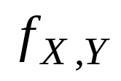
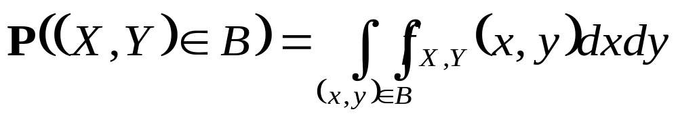
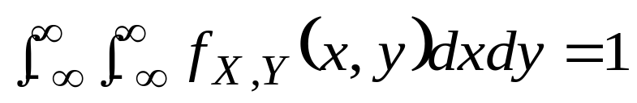




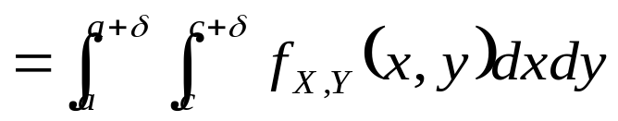
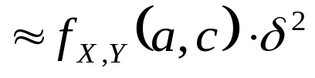
Joint PDFs of Multiple
Random Variables
Two continuous random variables and associated with a common experiment are jointly continuous and can be described in terms of a joint PDF if satisfies
  is a nonnegative function
  Normalization Probability
can be viewed as the “probability per unit area” in the vicinity of : let be a small positive number

Slide 3

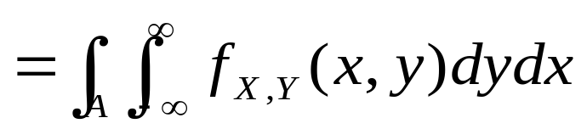


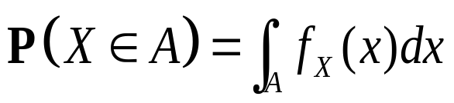

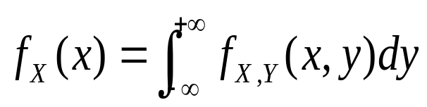
Multiple Continuous Random Variables
The joint PDF allows us to calculate the probability of any event that can be defined in terms of these two random variables. As a special case, joint PDF can be used to calculate the probability of an event involving only one of them.
For example, let A be a subset of the real line and consider the
event . We have
Comparing with the formula
we see that the marginal PDF of X is given by

Slide 4
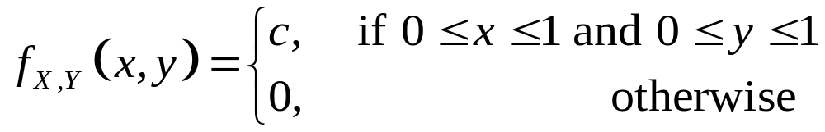
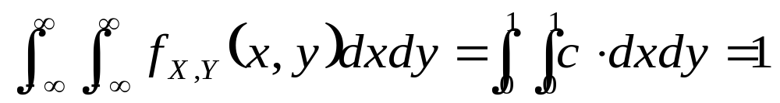
An Illustrative Example (1/2)
Example 3.9. Two-Dimensional Uniform PDF. Romeo and Juliet have a date at a given time, and each will arrive at the meeting place with a delay between 0 and 1 hour. Let and denote the delays of Romeo and Juliet, respectively. Assuming no pairs (x,y) in the unit square are more likely than others, a natural model involves a joint PDF of the form
For this PDF to satisfy the normalization property
we must have c=1, an example of a uniform joint PDF

Slide 5
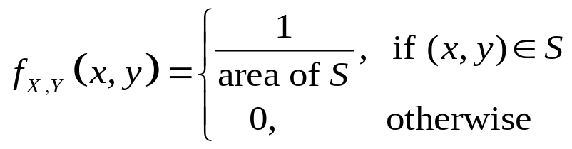

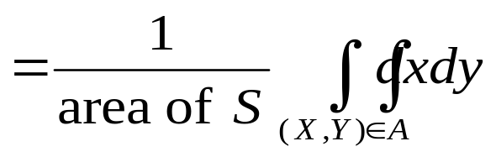

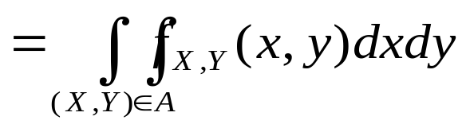
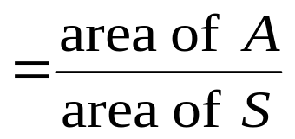
An Illustrative Example (2/2)
More generally, let us fix some subset S of the 2-dimensional plane. The corresponding uniform joint PDF on S is defined to be
For any set , the probability that (X,Y) lies in A is

Slide 6





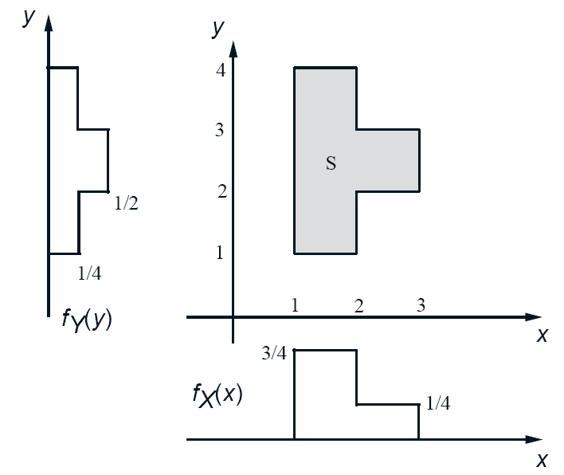
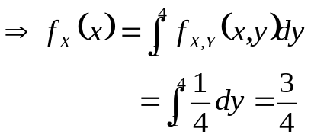

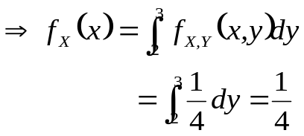
An Illustrative Example
Example 3.10. We are told that the joint PDF of the random variables X and Y is a constant c on an area S and is zero outside. Find the value of c and the marginal PDFs of X and Y.
The area of the set S is equal to 4 and, therefore, , for .
To find the marginal PDF for some particular X, we integrate (w.r.t. y) the joint PDF over the vertical line corresponding to that x. The resulting PDF is shown in the figure. We can compute similarly.

Slide 7

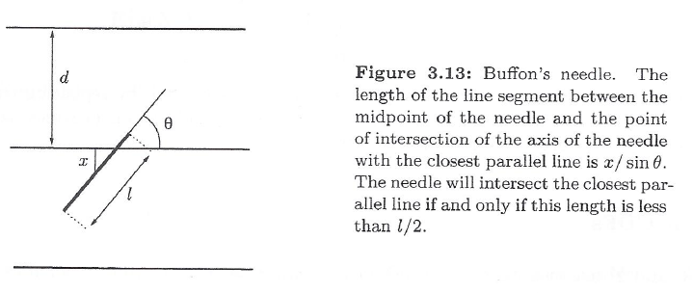
Another Example (1/3)
Example 3.11. Buffon’s Needles. This is a famous example, which marks the origin of the subject of geometric probability, i.e. the analysis of the geometric configuration of randomly placed objects.
A surface is ruled with parallel lines, which are at distance from each other. Suppose that we throw a needle of length on the surface at random. What is the probability that the needle will intersect one of the lines?

Slide 8




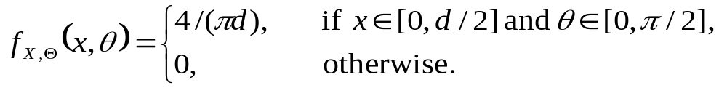
Another Example (2/3)
We assume here that so that the needle cannot intersect two lines simultaneously. Let X be the vertical distance from the midpoint of the needle to the nearest of the parallel lines, and let be the acute angle formed by the axis of the needle and the parallel lines. We model the pair of random variable with a uniform joint PDF over the rectangular set , so that

Slide 9
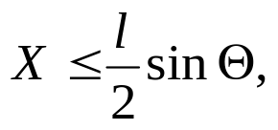
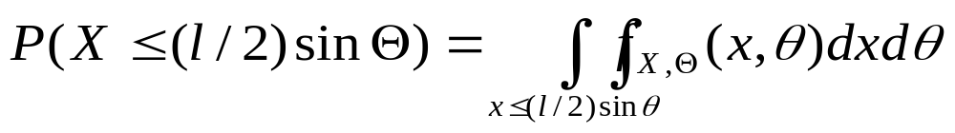
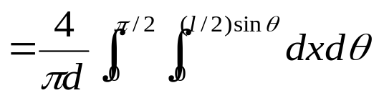
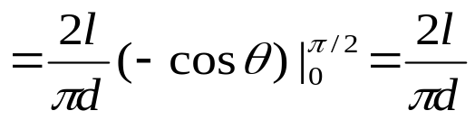
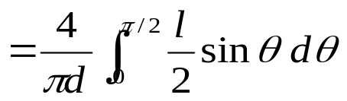


Another Example (3/3)
As can be seen from Fig. 3.13, the needle will intersect one of the lines if and only if
so the probability of intersection is
The probability of intersection can be empirically estimated, by repeating the experiment a large number of times. Since it is equal to , this provides us with a method for the experimental evaluation of .

Slide 10

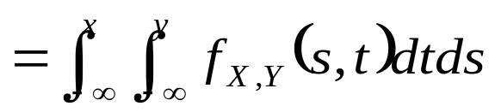
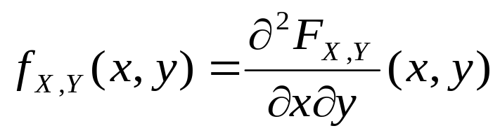
Joint CDFs
If X and Y are two continuous random variables associated with the same experiment, we define their joint CDF by
Conversely, the PDF can be recovered from the CDF by differentiating:

Slide 11






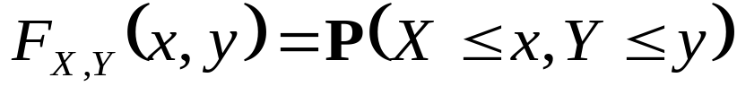

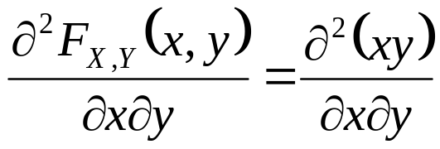

An Illustrative Example
Example 3.12. Let X and Y be described by a uniform PDF on the unit square. The joint CDF is given by

Slide 12


Expectation of a Function of Random Variables
If X and Y are jointly continuous random variables, and g is some function, then is also a random variable (can be continuous or discrete)
  The expected value of Z can be calculated by
  If Z is a linear function of X and Y, e.g., , then
Summary of facts about joint PDFs can be found on p. 164

Slide 13

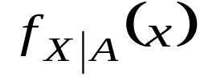
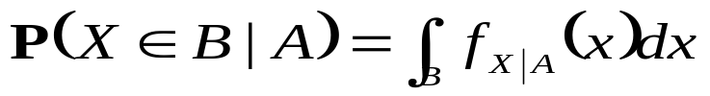
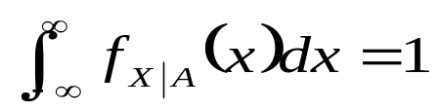
Conditional PDF on an Event (1/3)
  The conditional PDF of a continuous random variable X, given an event A with , is defined as a nonnegative
  function satisfying
  for any subset B of the real line.
  In particular, by letting B be the entire real line,
  we obtain the normalization property
  so that is a legitimate PDF.

Slide 14

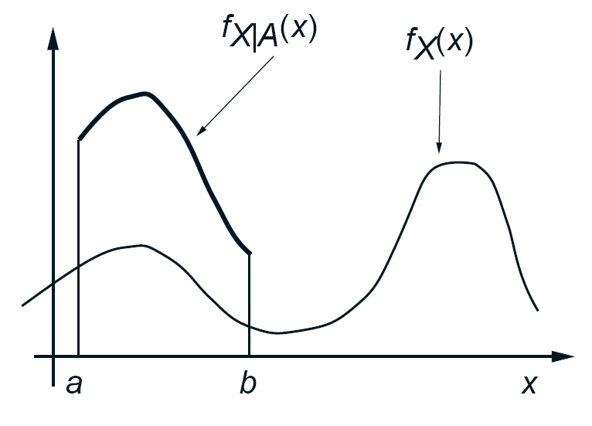
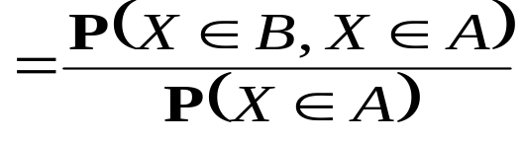

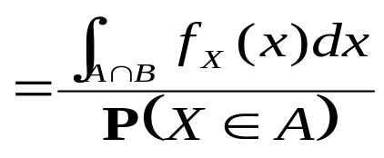



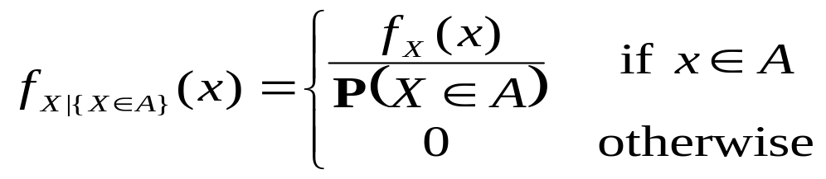
Conditional PDF on an Event (2/3)
  In the special case where we condition on an event of the form
  , with , the definition of conditional
  probabilities yields
  Comparing with the earlier formula, we obtain
remains the same shape as
except that it is scaled by the
constant factor

Slide 15




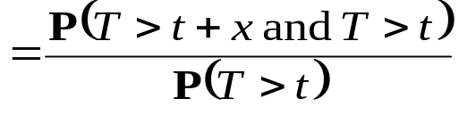
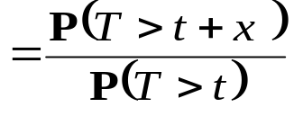
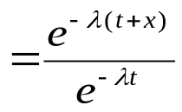


An Illustrative Example
Example 3.13. The Exponential Random Variable is Memoryless. The time T until a new light bulb burns out is an exponential random variable with parameter . Ariadne turns the light on, leaves the room, and when she returns, t time units later, finds that the light bulb is still on, which corresponds to the event A={T>t}. Let X be the additional time until the light bulb burns out. What is the conditional CDF of X, given the event A?
We have, for ,
Thus, the conditional CDF of X is exponential with parameter , regardless of the time that elapsed between the lighting of the bulb and Ariadne’s arrival, a property known as memorylessness property

Slide 16
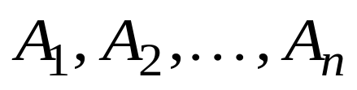
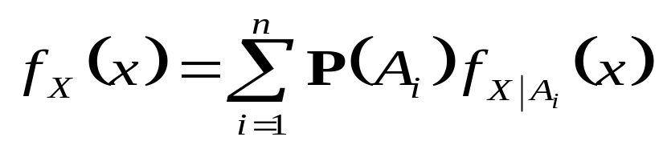
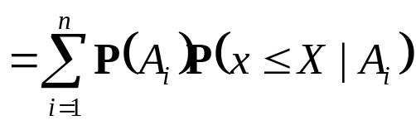

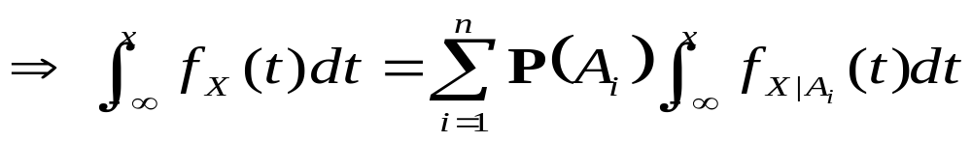
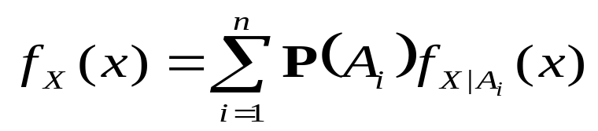
Conditional PDF on an Event (3/3)
If form a partition of the sample space, then
Verification of the above total probability theorem (Chapter 1)
Taking the derivative of both sides

Slide 17
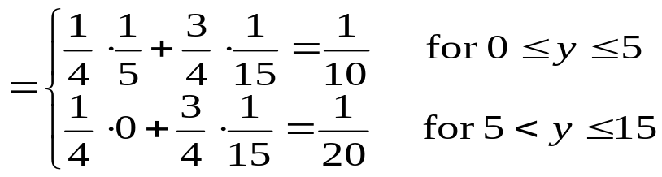


An Illustrative Example
Example 3.14. (divide-and-conquer) The metro train arrives at the station near your home every quarter hour starting at 6:00a.m. You walk into the station every morning between 7:10 and 7:30 a.m., and your arrival time is a uniform random variable over this interval. What is the PDF of the time you have to wait for the first train to arrive?
Let the time of your arrival be X and the waiting time be Y. Let A and B be the events
Conditioned on A, Y is uniform and takes values between 0 and 5 minutes.
Similarly, conditioned on B, Y is uniform and takes values between 0 and 15 minutes. The PDF of Y is obtained using the total probability theorem as follows.

Slide 18



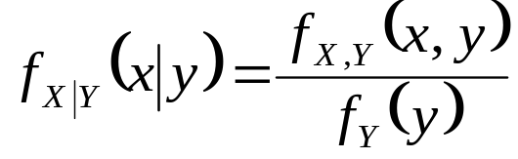
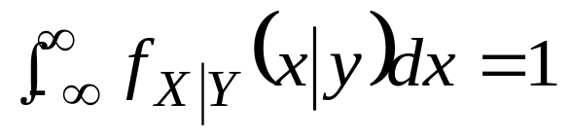
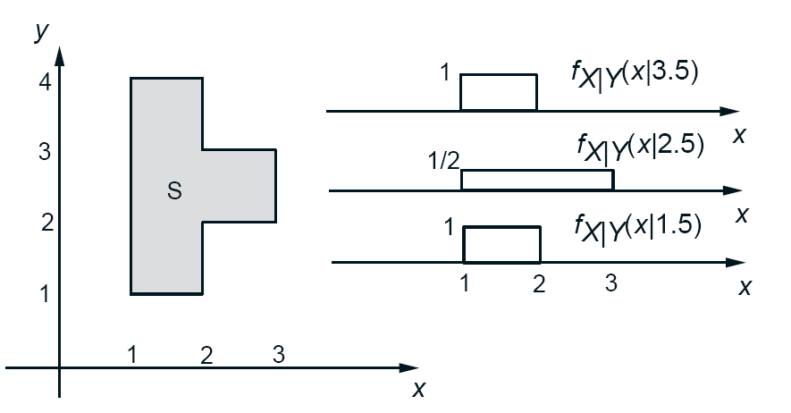
Conditioning one Random Variable on Another
Two continuous random variables and have a joint PDF. For any with , the conditional PDF of given that is defined by (viewing y as a fixed number)
Normalization Property

Slide 19






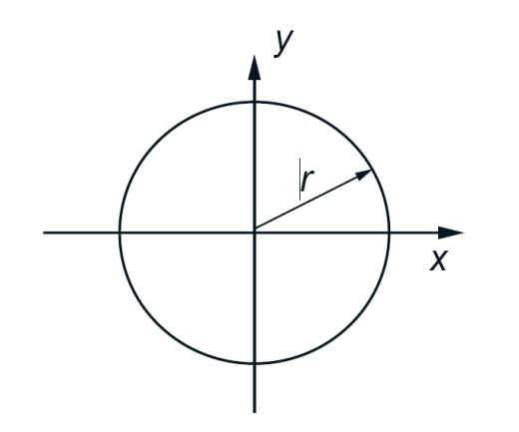
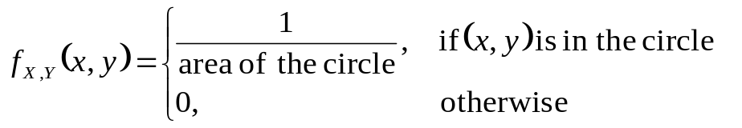
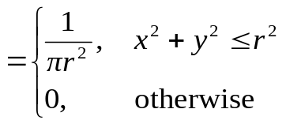










Illustrative Examples (1/2)
Example 3.15. Circular Uniform PDF. Ben throws a dart at a circular target of radius . We assume that he always hits the target, and that all points of impact are equally likely, so that the joint PDF of the random variables and is uniform
  What is the marginal PDF
For each value y, is uniform

Slide 20








An Illustrative Example
Example 3.16. The speed of a typical vehicle is modeled as an exponentially distributed r.v. X with mean 50 miles per hour. The police radar’s measurement Y of the vehicle’s speed has an error which is modeled as a normal r.v. with zero mean and standard deviation equal to 1/10 of the vehicle’s speed. What is the joint PDF of X and Y?
We have
Conditioned on , the measurement Y has a normal PDF with
mean x and variance . Therefore,
Thus, for all and all y,

Slide 21



Summary of Conditional PDF
Let X and Y be jointly continuous random variables with joint PDF . The joint, marginal, and conditional PDFs are related to each other by the formulas

Slide 22







Conditional Expectation
The conditional expectation of a continuous random variable , given an event ( ), is defined by
  The conditional expectation of a function also has the form
  Total Expectation Theorem
    Where are disjoint events with for each i , that form a partition of the sample space

Slide 23



Conditional Expectation
The above properties also apply to the event of Y = y
Natural analogs for the case of functions of several random variables

Slide 24






An Illustrative Example
Example 3.17 Mean and Variance of a Piecewise Constant PDF. Suppose that the random variable X has the piecewise constant PDF

